Slide 1
First-Line Dose-Dense Chemotherapy With Docetaxel, Cisplatin, Folinic Acid and 5-Fluorouracil (DCF) Plus Panitumumab (P) in Patients With Locally Advanced or Metastatic Cancer of the Stomach or Gastroesophageal Junction (GEJ): A Phase II Multicenter Trial
Abstract 146
Tomasello G, Liguigli W, Toppo L, Mattioli R, Negri F, Curti A, Ratti M, Poli R, Lazzarelli S, Gerevini F, Colombi C, Martinotti M, Rovatti M, Olivetti L, Passalacqua R
Notes:
Hi everyone, my name is …. I’m a medical oncologist from Cremona hospital, Italy. It’s a great pleasure to share with you the first results of this phase II single-arm multicenter trial of dose-dense chemo……

Slide 2
Background
Combination chemotherapy with docetaxel, cisplatin, and 5-fluorouracil (DCF or TCF) is a standard first-line regimen for metastatic gastric cancer¹
Dose-dense chemotherapy with docetaxel, cisplatin, folinic acid, and 5-fluorouracil showed to be an effective treatment for metastatic gastric cancer²
In metastatic colorectal cancer, the efficacy of panitumumab is limited to wild-type RAS expressing subtypes
KRAS mutation rate in gastric cancer is very low³
To date, only a phase III trial tested panitumumab efficacy in combination with EOC chemotherapy showing no survival benefit over chemotherapy alone.³ This was probably due to the high rate of toxicity observed in the experimental arm, which limited the delivery of an adequate dose intensity and to a possible negative interaction of panitumumab with one or more EOC components (ie, oxaliplatin)
Panitumumab activity when combined with DCF is currently unknown
In advanced gastric cancer it is possible to foresee at least an additive effect of anti-EGFR agent to chemotherapy, when combining these treatments
EOC, epirubicin, oxaliplatin, capecitabine
1. Van Cutsem E, et al. J Clin Oncol. 2006;24(31):4991-4997. 2. Tomasello G, et al. Gastric Cancer. 2014;17(4):711-717. 3. Waddell T, et al. Lancet Oncol. 2013;14(6):481-489.
Tomasello G, et al. J Clin Oncol. 2015;33(suppl 3): Abstract 146.
Notes:
DCF combination chemotherapy is one od the standard regimen for first-line treatment of metastatic gastric cancer.
Our group previously reported on the high activity of an original dose-dense variant of DCF.
As most of you are aware, Panitumumab alone or in combination with chemotherapy is effective in RAS WT metastatic colorectal cancer patients.
……

Slide 3
Treatment Schema
Docetaxel 60 mg/m2 day 1
Cisplatin 50 mg/m2 day 1
L-folinic acid 100 mg/m2 day 1, 2
5-fluorouracil 400 mg/m2 bolus day 1 and 2
5-fluorouracil 600 mg/m2 CI 22 h day 1 and 2
Panitumumab 6 mg/kg day 1
Peg-filgrastim 6 mg SC day 3
Cycles repeated every 2 weeks*
*Patients aged >65 years received a 30% dose reduction of all chemotherapy drugs. Dose of panitumumab was not reduced.
Chemotherapy was continued for a maximum of 6 cycles (4 cycles after the first amendment on 27/2/2012).
Maintenance therapy with panitumumab single agent was administered until disease progression, unacceptable toxicity, patient’s refusal or physician’s choice.
Tomasello G, et al. J Clin Oncol. 2015;33(suppl 3): Abstract 146.
Notes:
This slide shows the treatment schema composed by:….

Slide 4
Study Objectives
The primary objective was to assess the anti-tumor activity of panitumumab in combination with a dose-dense chemotherapy regimen in terms of overall response rate (ORR)* (complete and partial responses)
Secondary objectives were:
Toxicity and safety
Overall survival (OS)
Time to progression (TTP)
Translational research
*The estimate ORR for the treatment with chemotherapy alone was 45% (Dalla Chiesa M, 2007). We chose the lower activity (p0) of 0.45. The target activity level (p1) was 0.65. A total of 48 assessable patients were needed to guarantee 80% power under a [alpha]-level of 5%. Assuming that about 10% of patients would have been lost before evaluation (refusal or suspension for toxicity) the number of patients needed to enroll was 52.
Dalla Chiesa M, et al. J Clin Oncol. 2007;25(18S): Abstract 15068.
Tomasello G, et al. J Clin Oncol. 2015;33(suppl 3): Abstract 146.

Slide 5
Eligibility Criteria
Inclusion
Histologically confirmed advanced carcinoma of the stomach or esophagogastric junction
Patients with locally advanced not resectable tumors
Age ≥18 and ≤75 years
ECOG performance status ≤1
Adequate organ function
Exclusion
HER2-positive patients (IHC 3+ or IHC 2+ with FISH amplified)
Uncontrolled CNS metastases
Prior chemotherapy for the advanced disease
Clinically significant cardiovascular disease (including myocardial infarction, unstable angina, symptomatic congestive heart failure, serious uncontrolled cardiac arrhythmia) ≤1 year before enrollment
Tomasello G, et al. J Clin Oncol. 2015;33(suppl 3): Abstract 146.

Slide 6
Baseline Characteristics
 | n | %
Enrolled patients Metastatic Locally advanced not resectable | 52 47 5 | 100 90 10
Assessable for toxicity | 52 | 100
Assessable for response | 50 | 96
Age | 64.5 years ( median) 26 patients aged >65 years | Range 42-75 years 50
Sex: Male Female | 39 13 | 75 25
Performance status: 0 1 | 27 25 | 52 48
Metastatic sites: Lung Lymph nodes Bone Liver Peritoneum Other >1 metastatic site | 9 40 6 21 21 6 31 | 17 77 11 40 40 11 60
Histology: ADK Other | 50 2 | 96 4
Tumor grade 1 2 3 | 1 12 39 | 2 23 75
Tomasello G, et al. J Clin Oncol. 2015;33(suppl 3): Abstract 146.
Notes:
These are main patients characteristics. 52 consecutive patients were enrolled from 05/2010 to 01/2014. 90% of pts were metastatic and 10% locally advanced deemed not resectable. 96% were assessable for toxicity and all for toxicity. Median age was 64.5 years and half of the pts were >65 yeras old. 3 out of four patients were male. Most frequent sites of metastases were represented by lymphnodes, liver and peritoneum. Almost all the pts had adenocarcinoma as histology.

Slide 7
Results
 | n | %
Partial response | 29 | 58
Complete response | 3 | 6
Stable disease | 10 | 20
Progression | 8 | 16
ORR | 32 | 64 (95% CI, 51-77)
Disease control rate | 42 | 84
Not evaluable* | 2 | 4
* 1 patient died after 3 cycles of chemotherapy due to myocardial infarction; 1 patient died after the first cycle due to bowel occlusion
Tomasello G, et al. J Clin Oncol. 2015;33(suppl 3): Abstract 146.
Notes:
As for the results, we registered 58% of PR and 6% of CR for an ORR of 64% at per protocol analysis. The DCR was also very high reaching the rate of 84%.

Slide 8
Patients’ Compliance With Dose-Dense Schedule
 | n | %
Compliance with dose-dense regimen and no dose reduction | 22 | 42%
Compliance with dose-dense regimen and dose reduction | 16 | 31%
No-compliance with dose-dense regimen and no dose reduction | 8 | 15%
No-compliance with dose-dense regimen and dose reduction | 6 | 12%
Tomasello G, et al. J Clin Oncol. 2015;33(suppl 3): Abstract 146.
Notes:
Unfortunately, only 42% of patients managed to respect the dose dense criterion without any dose reduction or delay. A further 43% of patients had to reduce doses because of toxicity.

Slide 9
Toxicity
Grade 3/4 toxicity | n | %
Leucopenia | 15 | 29%
Neutropenia | 10 | 19%
Febrile neutropenia | 7 | 13%
Anemia | 5 | 10%
Thrombocytopenia | 4 | 8%
Asthenia | 14 | 27%
Mucositis | 7 | 13%
Nausea / vomiting | 6 | 12%
Diarrhea | 8 | 15%
Skin toxicity | 13 | 25%
Hypomagnesemia | 2 | 4%
Toxic deaths | 2 | 4%
Tomasello G, et al. J Clin Oncol. 2015;33(suppl 3): Abstract 146.
Notes:
Particularly, most frequent grade 3-4 toxicity observed were: leucopenia at a rate of 29%, neutropenia in 19% of cases despite the use of pegfilgrastim, FN in 13%. As for Panitumumab related toxicities we registered 25% of g3-4 skin toxicity and 4% hypomagnesemia. Asthenia was also not negligible.

Slide 10
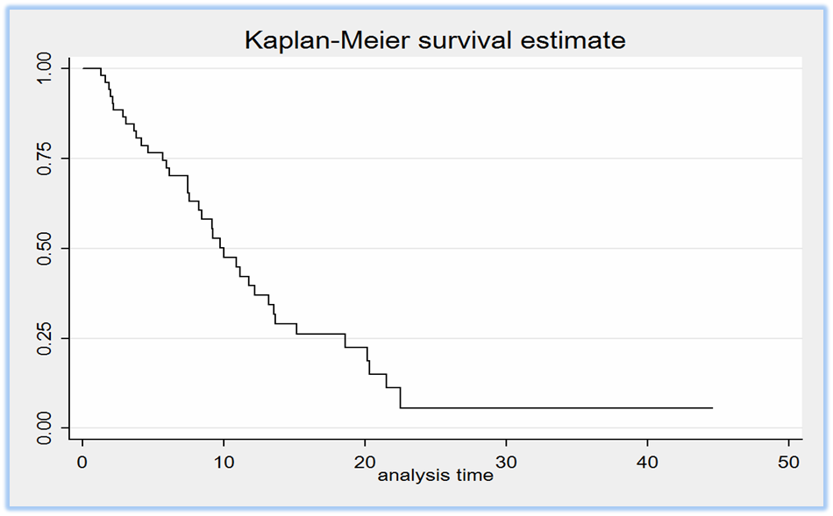
Secondary Endpoints: OS
Median OS: 9.4 months (95% CI, 7.4-11.6)
Tomasello G, et al. J Clin Oncol. 2015;33(suppl 3): Abstract 146.

Slide 11
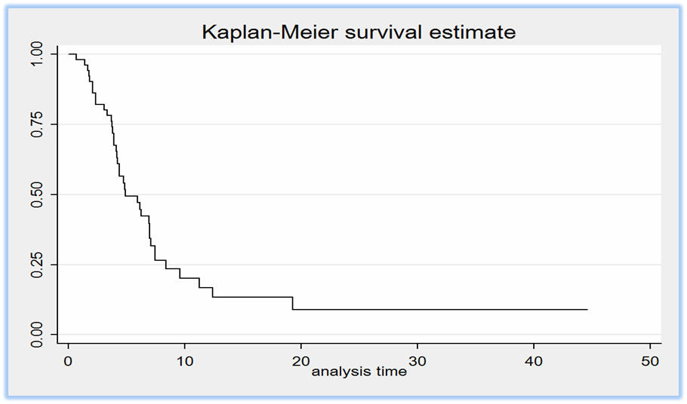
Secondary Endpoints: TTP
Median TTP: 4.8 months (95% CI, 4.1-6.9)
Tomasello G, et al. J Clin Oncol. 2015;33(suppl 3): Abstract 146.

Slide 12
Summary
At our knowledge, this is the first study in gastric cancer which combines a monoclonal antibody with a dose-dense chemotherapy regimen, followed by maintenance therapy with panitumumab single-agent
Primary endpoint of the study has been reached with an ORR of 64% with the addition of the antibody; OS and TTP are in line with literature data
Due to toxicity, only 42% of patients respected the dose-dense schedule with no dose reductions. Likewise REAL-3 study, this confirms the difficulty in administering an intensive chemotherapy regimen in combination with an anti-EGFR antibody
50% patients entered the maintenance phase with panitumumab, which was administered for a median of 14 weeks
Seven patients (13%) not receiving maintenance therapy underwent gastrectomy. In an exploratory analysis comparing this subgroup with patients with no surgery (24) or gastrectomized before study entry, median OS was 20.0, 8.4, and 9.7 months respectively
Dose-dense chemotherapy combined with panitumumab is a very active regimen in gastric cancer
Due to a not negligible toxicity profile, it may represent a treatment option in neoadjuvant setting
Further translational studies aimed at identifying reliable predictive biomarkers are definitely needed
Tomasello G, et al. J Clin Oncol. 2015;33(suppl 3): Abstract 146.
Notes:
Conclusions: at our knowledge this is the first study which evaluate at the same time three important variables:

